Slide 1
BDD in Blazor

Slide 2







Un grazie agli sponsor

Slide 3







E alle community che ci hanno supportato

Slide 4



Scenario

Slide 5

Ma io faccio backend !?!?!

Slide 6
Maybe …
The lowest level of knowledge is when we make a lot of decisions about the future system
It’s easy to make things complicated, but it’s complicated to make them simple

Slide 7

Che problema c’è?
Risk comes from not knowing what you are doing
(Warren Buffet)
The only way to decrease ignorance is to increase understanding

Slide 8
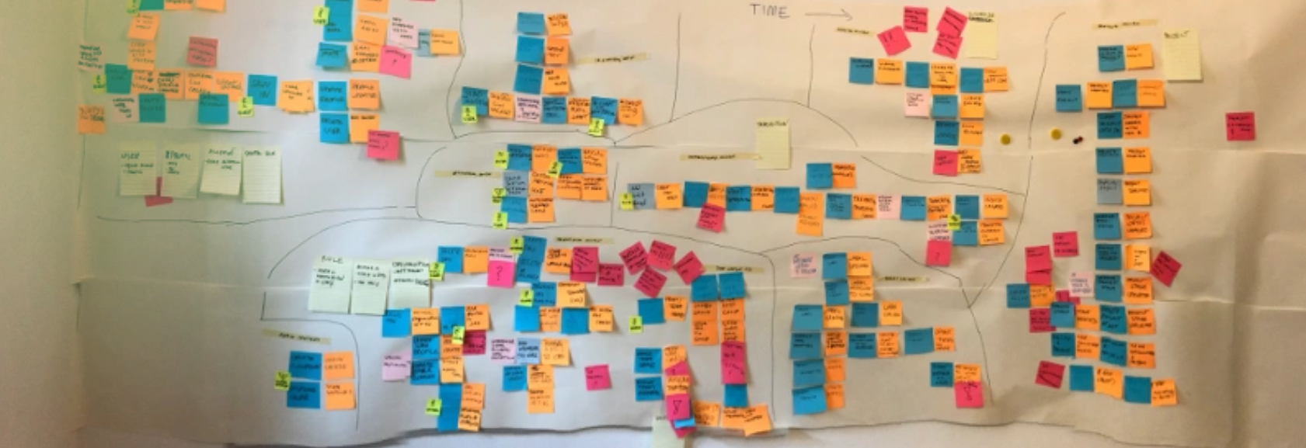
Da dove inizio?

Slide 9
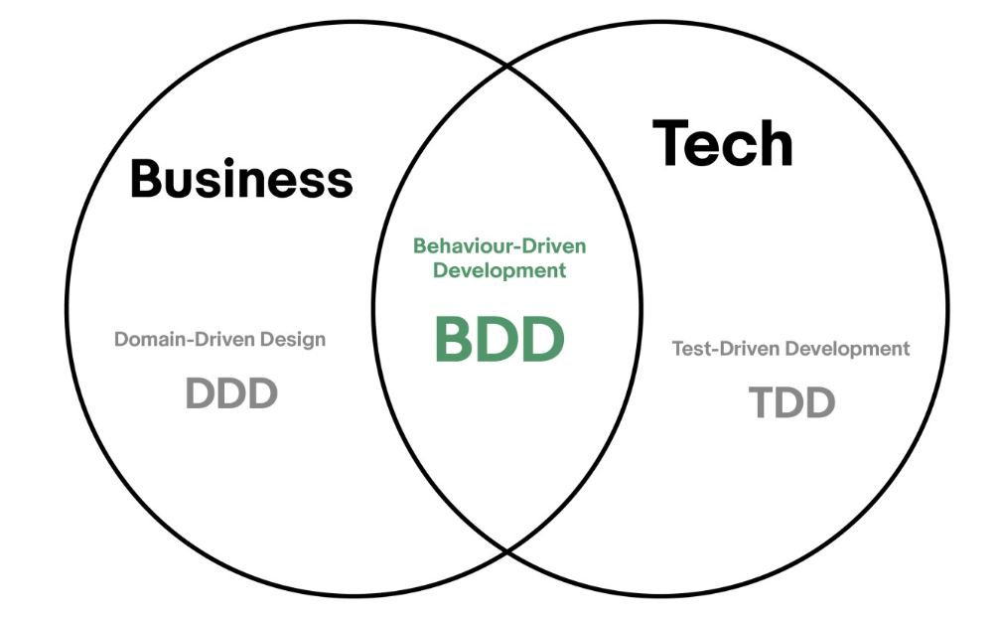
Ovviamente dai Test

Slide 10
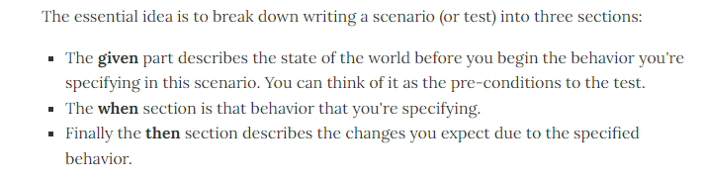
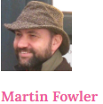
What?

Slide 11
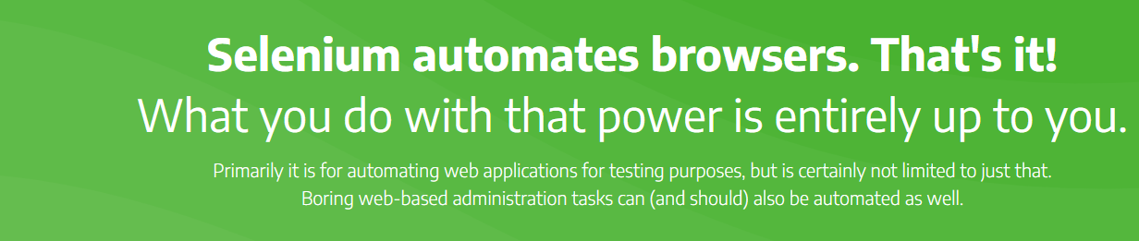
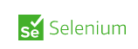

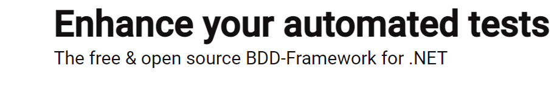
Cosa ci serve?

Slide 12
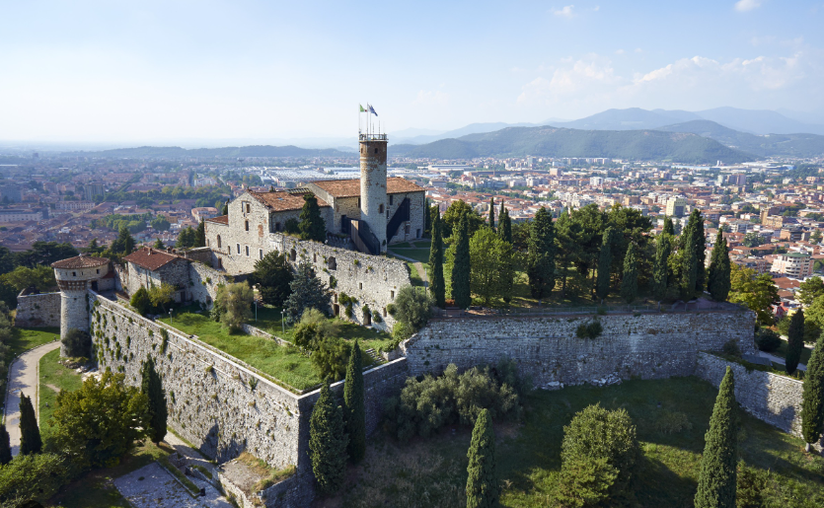
Demo
KEEP CALM
and
POTA

Slide 13
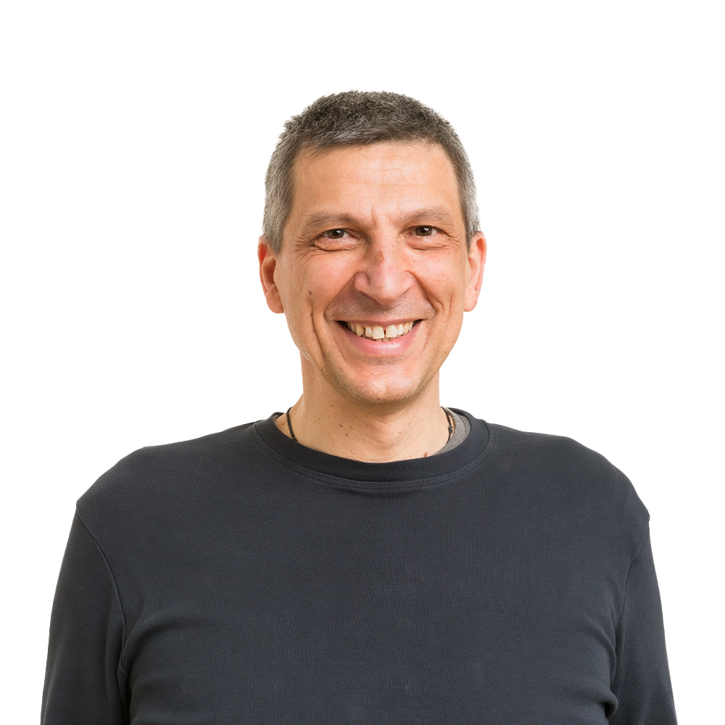







About Me
alberto.acerbis@intre.it
https://github.com/brewup
https://github.com/cqrs-muflone
https://github.com/ace68
https://www.twitch.tv/dddbrewup

